Slide 1

Intelligent Driving Behavior analysis
1352923 mazhiyuan
1354202 wangyuqing

Slide 2
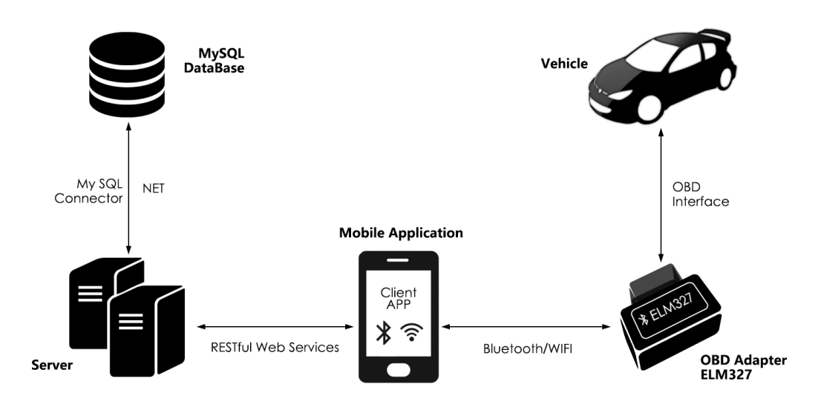
General Architechture
点击添加文本
点击添加文本
点击添加文本
点击添加文本

Slide 3
Features Of Mobile Application
点击添加文本
Retrieve data
from the OBD
Interface
Display real-time data and
driving behavior report
generated by server
点击添加文本
Upload data
to the server for
storage and analysis
Client sign up/sign in
点击添加文本
点击添加文本

Slide 4
Techniques
点击添加文本
点击添加文本
Universal Windows Platform (UWP)
app development
Java and .NET interoperability
IKVM
点击添加文本
点击添加文本

